Slide 1
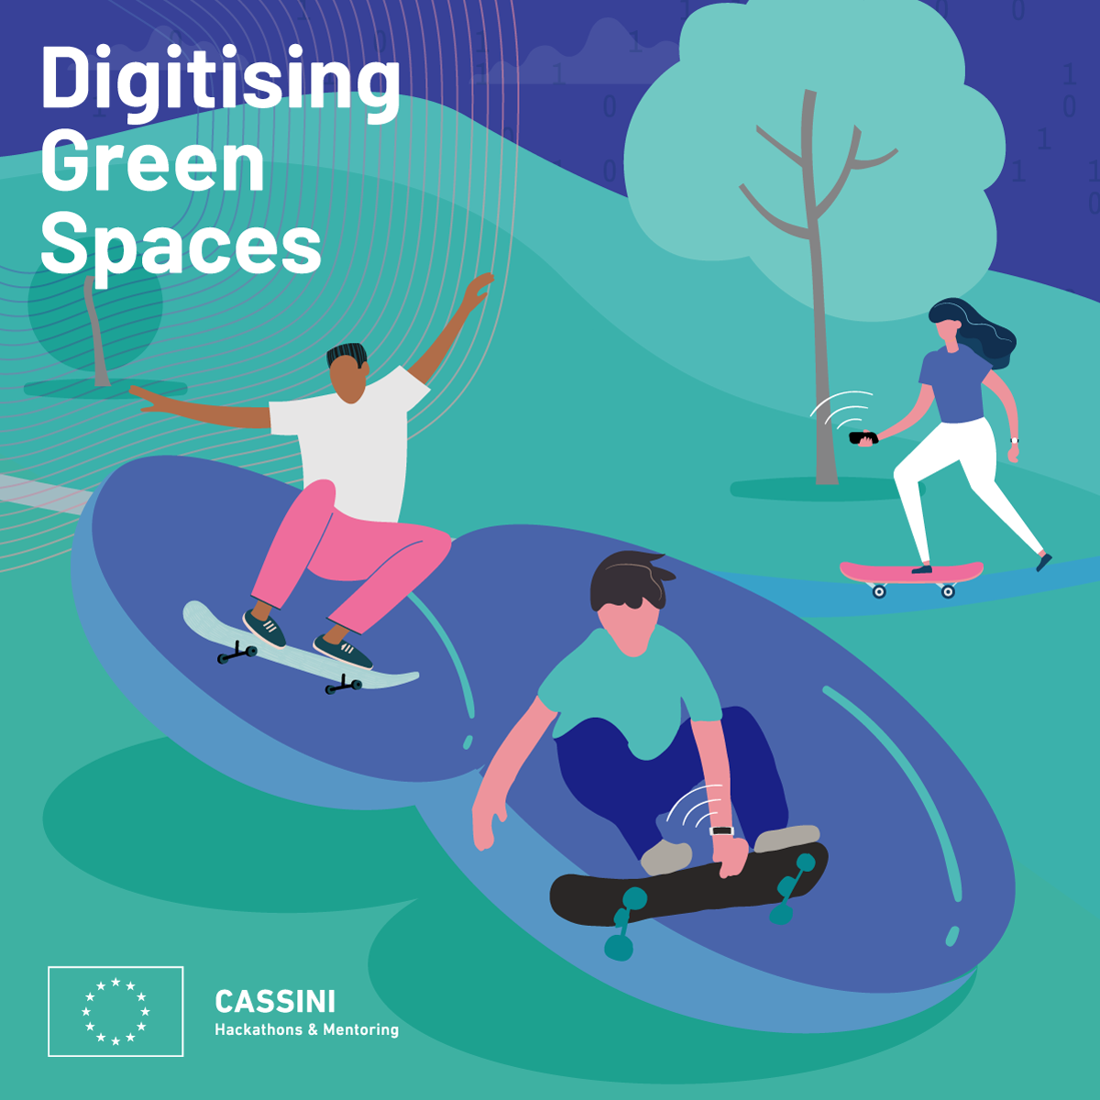

CASSINI HACKATHON GREECE
Go Green
A project prepared by Gen XYZ
20/06/2021

Slide 2



Expected Outcomes
Draw a detailed specification
Evaluate data sources
of citizen needs (i.e. hikers, runners, city breakers) and outline solutions that can be used to tackle them.
that can be used to implement these solutions (Copernicus Hub i.e. Sentinel 2, MODIS etc)
Link the proposal to a business plan
Deliver a Proof-of-Concepts
providing commercial opportunities for furthering application development.
in the form of an interactive web application (supporting testimonials and tips) to validate the scope and content of the proposal.

Slide 3
“A walk in nature walks soul back home”
Ancient Greek Quote

Slide 4
Our Team
EVANTHIA KOTSI
LENA KYROPOULOS
Civil - Transportation Engineer. MSc Student in Geo- informatics.
MSc Student in Qualitative Journalism and New Technologies at ECI European Communication Institute. PTA in Physiotherapy. Poet. Song-writer. Comic cartoonist.
ARIS TRITAS
LAMPROS MOUSELIMIS
MSc in Machine Learning. Data Scientist. CTO of TTROTT.
Business Administration.
Geo-data and Coding Enthusiast.

Slide 5
THE INSPIRATION BEHIND GO GREEN!
Especially after the pandemic of COVID-19, our mission is to motivate people to reconnect with nature, exploring unknown green places with more detailed info about trails routing and special features, and finally enjoy all the benefits that wellbeing (cognitive, physical and psychological balance) offer to them.
Generating EQO-Q intelligence

Slide 6


Routing the user to the best location
According to the received info the user can plan, better,
save time, enjoy the moment
health matters : 1) protection ej UV / skin protection
: 2) Prognosis ej Air pollution / respirations
issue, another destination choice of green place
Feedback solicitation after the hiking experience
Specification of a typical user interaction with the app

Slide 7


Possible User Workflow
Feedback solicitation after the exercise
The user chooses some POI to narrow down the available green space.
Users don’t want to be disturbed during the exercise. Once it’s over, we present a recapitulative screen with stats, and let the users provide some feedback (rate the exercise, rate the difficulty level etc.)
Either around me or some specific green space name.*
The user chooses an activity type
The user chooses a time frame that will be used as inputs for the forecasting model.
we focus on some common/popular choices, i.e. walking, running, bicycling.
Notes:
*We will not have access to precise geolocation data in the context of the PoC: the neighbourhood name can be a substitute for the “around me” choice.

Slide 8
12,24 billion market
According to our research in “Wonder” and in “Ibis” we realized that the specific customer behaviour of this market will be increased the next years with a very important growth rate. To conclude, there are over 118.26 million people who hike globally and the global market size for hiking is $12.24 billion.
https://askwonder.com/research/globally-people-practice-hiking-global-market-size-sport-ydayybulj

Slide 9


Plus factor
Our advantages: Greece has a great weather and you can have these outdoor activities almost 90% annually. Not only domestic users, but also tourists can be attracted by this
crowdsourcing & crowdcreation
We could also make a web-doc to promote these trails and our app / synergies with film and documentary universities and culture exchange / research institutes . We have this kind of Net- Work with Universities of India, Slovakia, Usa, Albania, Italy and Greece ,Bulgaria and the Canadian department of film and T.V. Documentary University in Bangladesh and Its Research Center
Foundation / Advantage we are partners with the cyclist of the world, where you can see in the following wikipedia link and he has a huge network of 51 municipalities and many hikers and bikers in balkan regions and in Europe as well/ - funded by the Europe Creative.
We could build a great net- work with the european trails and hiking lovers and to create unique long distance trails : discover Greece on your way, or to make also collaborations on a volunteering basis on crowdsourcing and crowd creation people. The following example took place in Spain
https://bit.ly/35DJRsh

Slide 10
DISCUSSION
The prototype is limited to the region of Attica but we firmly believe that we can extend it to all of Greece, Europe and the rest of the world.
The application can become personalized, suggesting locations based on:
the user’s schedule (e.g. outside working hours, outside car congestion peak hours)
expressed activity preference (e.g. trekking in the mountain over jogging in the park, or vice-versa).
historical filter settings (UV indicators, temperature/humidity measurements)
The application can also be social: integrations with calendar and communication apps can be used to invite friends and family for some scheduled outdoor activity.

Slide 11
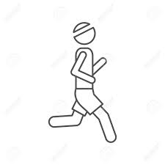
Core customer audiences
INDIVIDUAL INTERESTS
GENDER
10%
50%
30%
50%
50%
10%

Slide 12
Business opportunities
ECO-RESPONSIBLE RETAILERS
NON-INVASIVE AND PRIVACY-PRESERVING BUSINESS LISTINGS
MATCH-MAKING BETWEEN CITIZENS AND COACHES AND/OR PHYSIOLOGISTS
“airbinar”
air→ outdoor activity
& the ending like seminar- webinar
Acting to preserve green space. Creteria:
- usage of recyclable materials,
- bicycle parking
- EV charging stations
- Magnetic Vehicle Charging.
By putting them on the map, we believe that citizens will notice and search for these locations, thus providing tangible business value that we can monetize as well. ry is the closest planet to the Sun and the smallest one in the Solar System—it’s only a bit larger than our Moon
or selected partners and timely user recommendations based on geolocation (how about a smoothie after your long jog?)

Slide 13
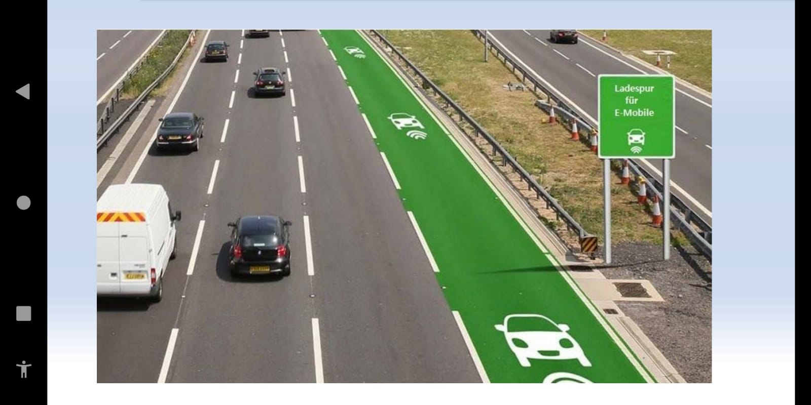
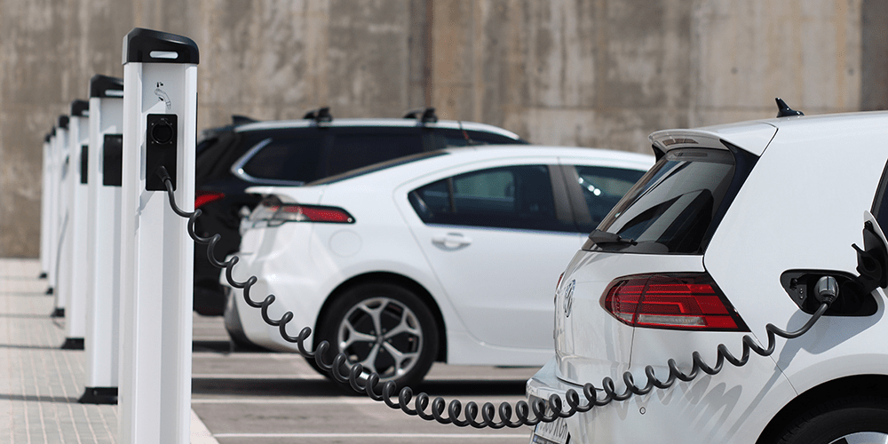

EQO-Q intelligence

Slide 14
.
Commercial part 1
special life experience,
We build nature lovers and explorer’s community with aggregate targeted info
The next step could be to link them with hotels, hostels, med-care, even their equipment suppliers,
The purpose has also a social impact because it reflects on the the specific community of the trails, hiking lovers and city breakers globally.
We have chosen Greece and especially Athens about Its unique geomorphological environment. We have on our mind to extend this app also to the Greek islands.
Cultural part 2
We can combine our app with cultural background / This is for 2050 approach
.

Slide 15

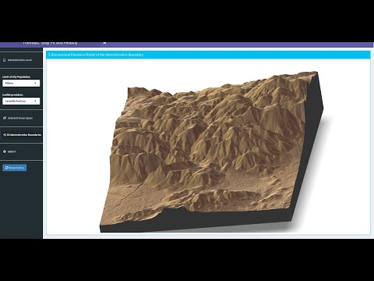
Desktop software

Slide 16
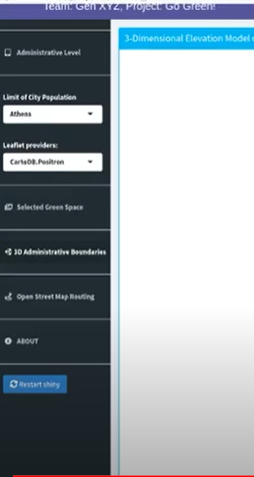
Media accessibility & b2b e-commerce
Promotion & Marketing Campaign : In our team we have a journalist can write an essay about the specific topic and make a media and tourism conference . www.bcimediainc.com is one of the largest media platform which you can find in 126 platforms globally and has approximately per day 1.5 m users. and collaborates with Apple TV, SAMSUNG and KODI
One member of our team is related to the https://b2bgrowthpro.com/ a huge Network of 68 countries and 8.500 registered companies . We can have a demo of our app in this site for potential customers
corporate social responsibility

Slide 17
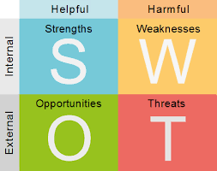
Q- BUSINESS : If we would like to be funded with 50.000 E we have to saw to investors business canvas that our project/ product is qualified to have a turn over of 500.000 E to cover this expectation we need at least
12.500 customers / 5 years
Per customer = annually fee is 40,00E
In 5 years it will be 200, 00 E
Generally we will reach 2.500.000 in 5 years
Profit margin of the investor 30%
Win approximately 750.000 E in 5 years
Competence
Mammoth Tracks , AllTrails, Map My Hike, Gaia, Google maps, Weather Underground, picture this, and Skyview,
min 39,00 $ max 120,00$

Slide 18
THANKS!

